Slide 1

Safe Klutcher

Slide 2
Abstract

Slide 3
The aim of the project is to tackle the main issue usually raised, which is the lack of a user-friendly application which deals with protecting sensitive data in corporate industries , local business etc which could harm the integrity of the firm.
The project is to develop tool which helps us to identify possible suspects and provide surveillance data of the time of data breaches that happen .
Our tool uses complex encryption algorithm to encrypt sensitive data which is difficult to get decrypted .

Slide 4
Introduction

Slide 5
More and more data records are being lost and stolen everyday. As breaches continue to plague in organization and the impact to individual increase,the need to protect such breaches has increased.
if we work on our project we need to work with files that contain privileged information which is stored in our computer disk and the best way to secure those files is by using encryption tools.
Thus need of encryption tools have become very important in today’s world .
Therefore, the aim of this work is to provide tools that safeguard firm’s integrity.

Slide 6
Literature Review

Slide 7
Advantages of Project
No severe inherent vulnerabilities have been found in our encryption algorithm.
Provide enough evidence to investigators to find the person who tried to open sensitive data.
Implementation is fast.
Disadvantages of Project
Forgetting Passwords may lead to lost data.
RSA algorithm restrict us in many ways like it makes it difficult to add different features to the algorithm to make a full fledge tool.
Adding features was making the algorithm vulnerable.

Slide 8
DIFFICULTIES and MITIGATION 🥴
While making this tool implementation speed increased rapidly because of adding different features to it thus we identified features which were taking too much time to implement. We, either removed them or tried to make them more efficient .
Being a multifunctional tool it is difficult to make the whole tool in one go thus we divided the whole project in sub projects and then integrate it at the last.
Finding bugs in the code was a challenging task , we made many mistakes to give proper input to the program so that it can run .

Slide 9



Tech Used
Atom
Teletype
MinGW

Slide 10
Proposed Methodology
Now here we are trying to explain the proposal using flow diagram

Slide 11
GOAL
To secure a file using a hybrid RSA cryptographic technique.
Collecting important digital forensic evidences to save time in case of emergencies.
APPROACH
Python
Java
C++

Slide 12
The first idea was Python as it has many in-built libraries that could make it easy for us to code. But as we haven’t studied Python in dedicated curriculum yet, we were facing difficulties in coding.
Java didn’t have all the libraries and also same problem with python occured here that is we were not very much comfortable with coding here.
Finally, we decided to with C++ as we have studied it in our previous semester. So, we are comparatively comfortable with it.
SURVEYS
Que 1- Do they have sensitive files on their computers?
Que 2- Do you like to protect them?
Que 3- How are they protecting them currently?
Que 4- Do you know how to check logs in Windows?
Que 5- What do you think about a program code that can encrypt their file as well as can give them details of every login?

Slide 13
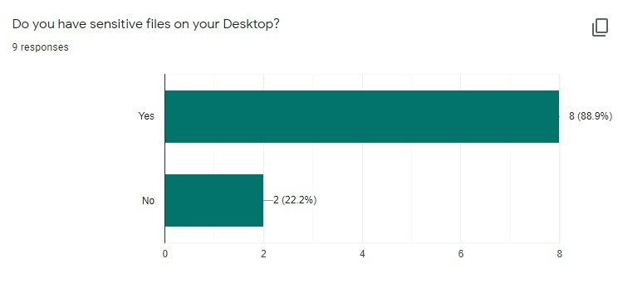
ANALYSIS
Que1.
We figured out that not only in firms but, in general people, do have sensitive files in their computers.

Slide 14
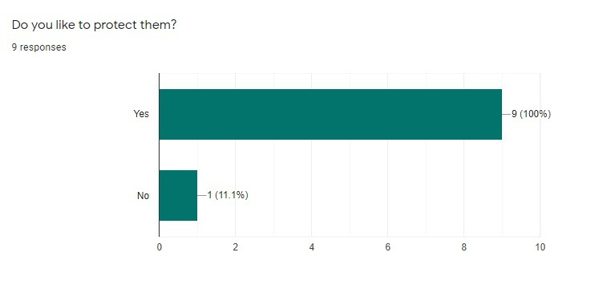
Que2.
Almost everybody serveyd wanted to protect their important and sensitive files.
Only 1 out of 10 came out to be a little neglectant, the reason could be less importance of file.

Slide 15
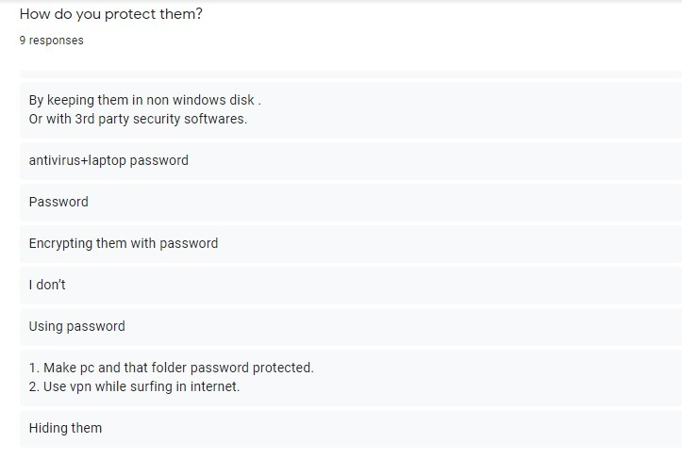
Que3.
Most of the people are using antiviruses for protecting their sensitive files but antivirus only saves your file from malware or virus attacks.
Using passwords does not provide encryption. It just puts a lock to your file but it can be penetrated.
Some users are neglectant using the “hiding the file” option to protect their files. It is most unsafe method.

Slide 16
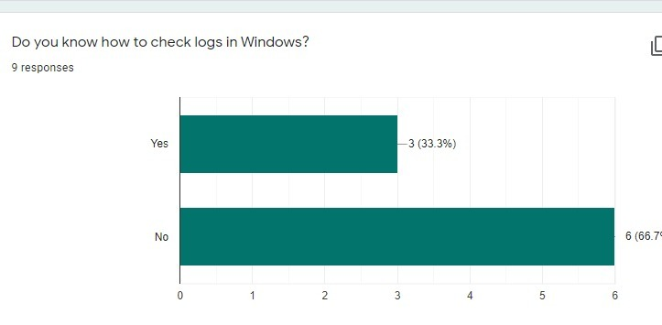
Que4.
From the survey we found out that only 33.3% of people surveyed know that how to check system logs.
Checking system logs is not at all an easy task. It takes a power user to do so.
Searching for the logs useful to us is very difficult as their are thousands of logs about all the processes going on in the system.
When some mishappening occurs in the company, DFIR team will lose so much precious time in collecting evidences.

Slide 17
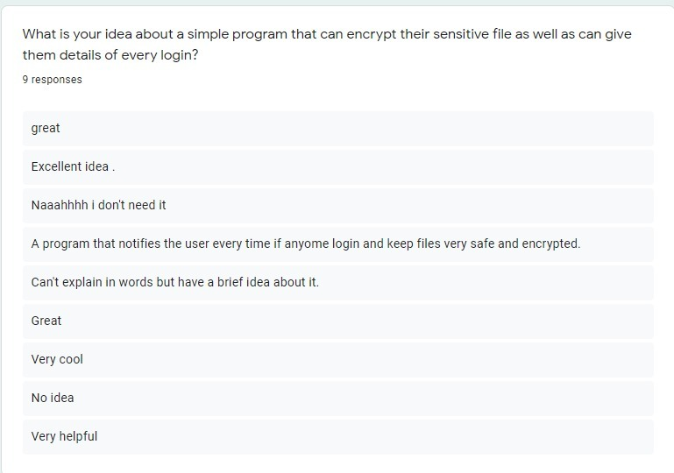
Que5.
People really liked the idea of using a software that can protect, encrypt and keep the individual logs of their important file.
This really give us a boost to work on this project.

Slide 18
EVALUATION
We found out that searching for useful logs in general, takes a lot of time and Power User skills, so we have stored the logs of protected files separately.
To check who have logged in or who attempted to log in the file, we decided to click their photo and store it in a personal database.
END

Slide 19
Implementation Details

Slide 20
We tried to give an overview of how the project is going to work in the Command Line interface.
The following pictures gives a basic idea of how the program will process and how the output will be generated.

Slide 21
HELLO! Which operation do you want to perform?
Encrypt the file.
Open the encrypted file.
Please, enter the input here : _________

Slide 22
A.
Great choice!! Encrypting your files with a password leads to better security of the file.
So, please enter the path of the file you want to encrypt:
_____________
Your file is successfully encrypted!
Your password is : _______________

Slide 23
B.
Hi!! Wanna open the file??
Firstly, Enter the path of the file:
(syntax: D:\\folder_name\\file_name.txt)
________________________________________
Enter the password here: _______________

Slide 24
To understand the details of implementation, let’s start with the main() of our program:
Firstly, we are generating a sequence of pseudo-random integer values using
srand(time(NULL));
srand is used to set the starting value (seed) which makes use of the computer's internal clock to control the choice of the seed.
Then we are taking file as input and reading its content.
Then we are generating private and public keys using generate_keys() function.
Then we will call encrypt and decrypt function to encrypt and decrypt the file.
Following are some pieces of our code that we have half prepared for encryption and decryption using RSA algorithm-

Slide 25
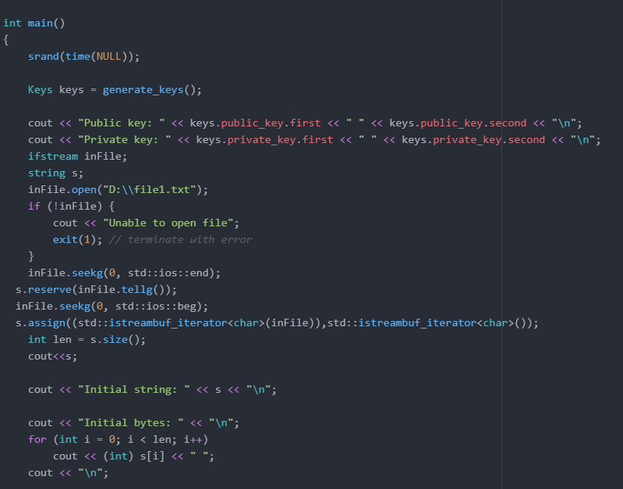

Slide 26
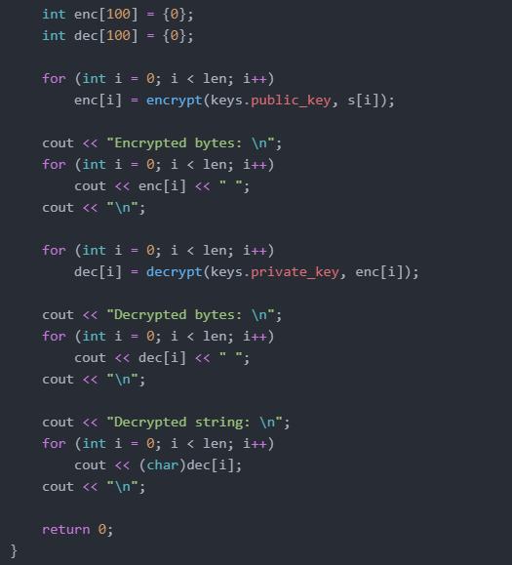

Slide 27
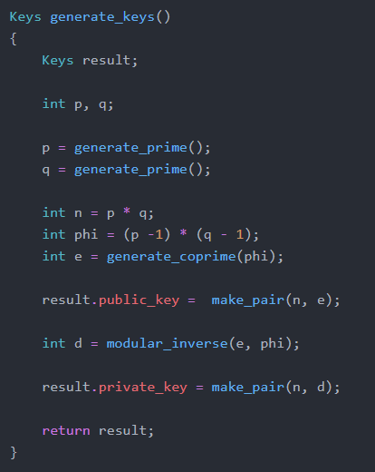
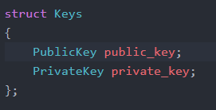
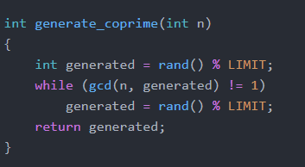

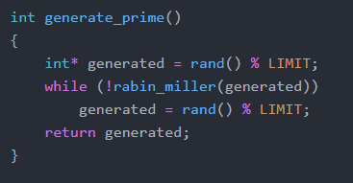

Slide 28
Conclusion

Slide 29
COMPLEXITY:
While Encryption or Decryption ,
C:=M^e mod(n)
So, complexity = O( n²).
There can be total of n characters,
So, complexity = O(n).
Net Time complexity = O(n) * O(n^2)
= O(n³)
2. While collecting log details,
Here we are using only the ‘cout’ keyword to get the logs of file.
So, the complexity comes out to be = O(1)
Hence, it is not using anytime means we are simply adding this function
without adding any extra running time to total time to the program.
3. While clicking the picture of user,
Yet to be calculated...

Slide 30
PASSWORD:
We will be generating a random password to the user so that there is no pattern in the sequence of generation.
DATABASE :
We are planning to save on a real time database:
The file of user to be protected (the file will be kept confidential).
The password provided to user.
The logs recorded by our C++ program.
The picture clicked on logging in.

Slide 31
References

Slide 32


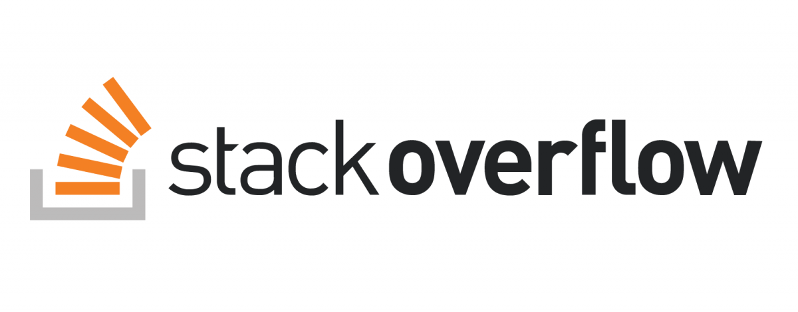


Slide 33
ThankYou😊
Group Cyber07
Vipul Jaiswal - 19BCY10016
Adnan Khan - 19BCY10051
Saloni Gupta - 19BCY10007
Priya Sharma - 19BCY10077

